Slide 1
6.7 Factoring: a general strategy
ALGEBRA CONCEPTS

Slide 2
What Method Do I Use??
1. Always look for a GCF first
  If there is a GCF take it out!
2. Look at the number of terms
  Two terms: Difference of Two Squares?
  Three terms:
    If the Coefficient is 1, Use the Short Cut
    If the coefficient is not 1 Use Factor by Grouping
ALWAYS FACTOR COMPLETELY WHICH MEANS EVERYTHING IS IN ITS SIMPLEST FORM!!!

Slide 3

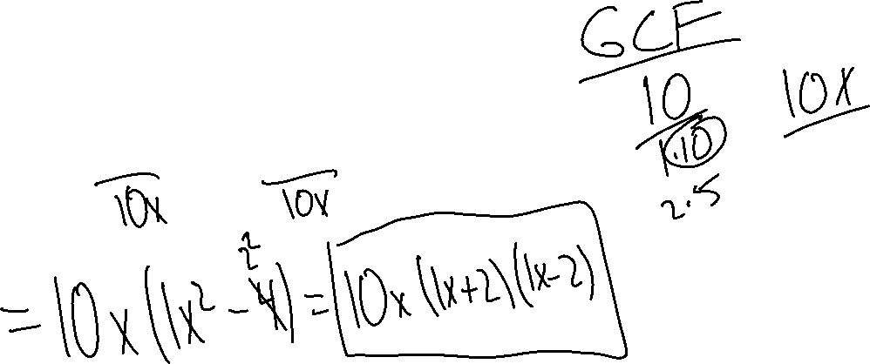
Factor
Ex. 1) $10x^{3}−40x$

Slide 4

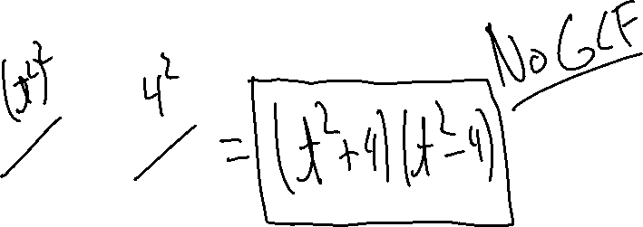
Factor
Ex. 2) $t^{4}−16$

Slide 5

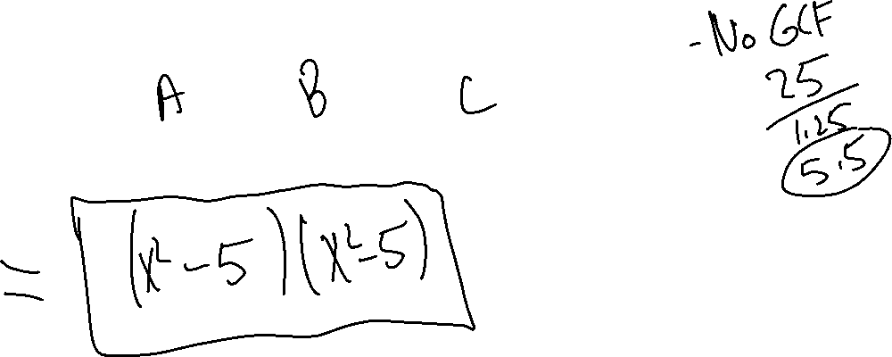
Factor
Ex. 3) $x^{4}−10x^{2}+25$

Slide 6

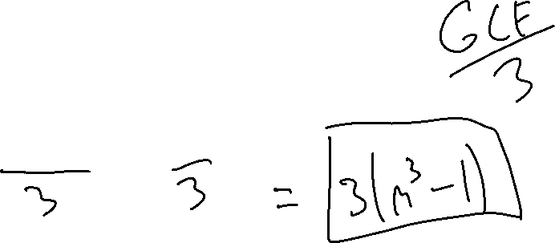
Factor
Ex. 4) $3m^{3}−3$

Slide 7

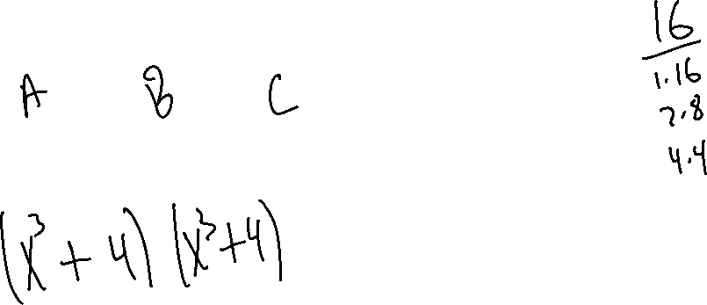
Factor
Ex. 5) $x^{6}+8x^{3}+16$

Slide 8

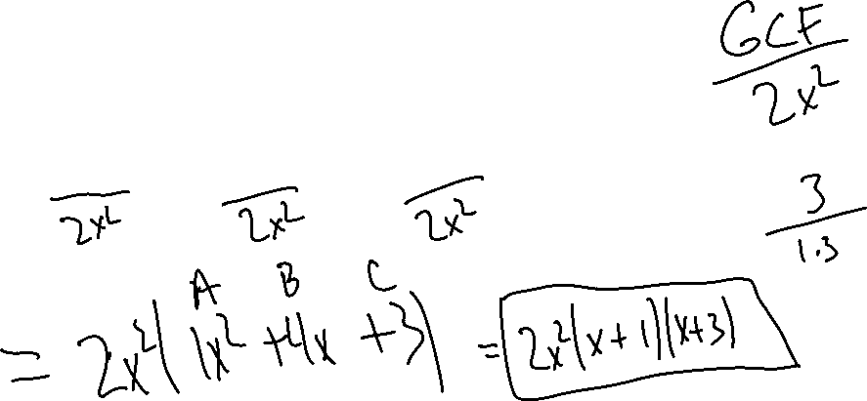
Factor
Ex. 6) $2x^{4}+8x^{3}+6x^{2}$

Slide 9

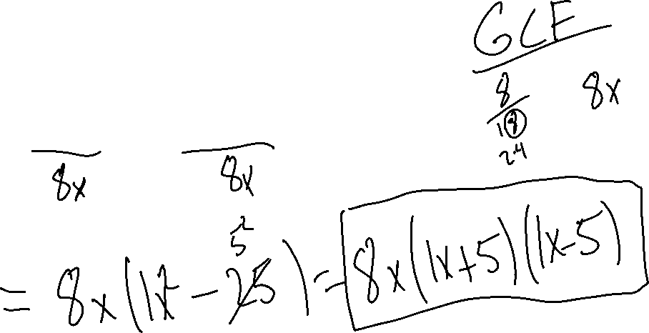
Factor
Ex. 7) $8x^{3}−200x$

Slide 10

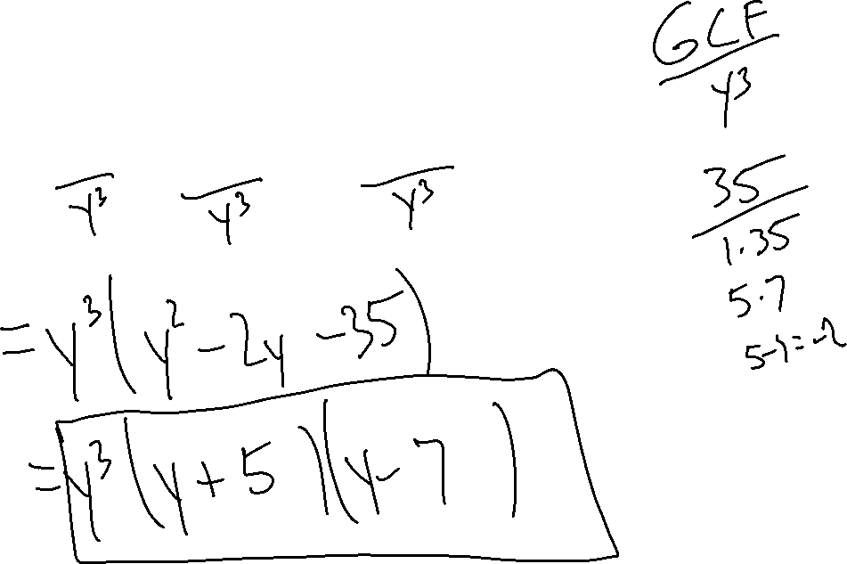
Factor
Ex. 8) $y^{5}−2y^{4}−35y^{3}$

Slide 11
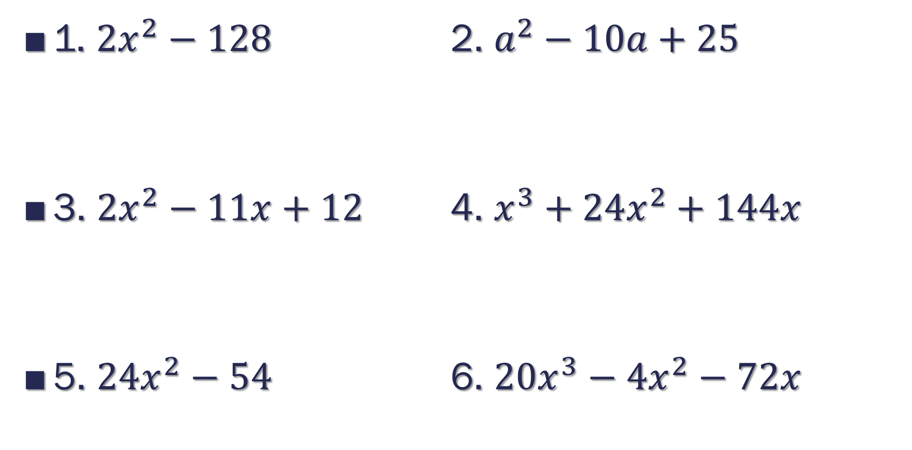
Try These
1. $2x^{2}−128$ 2. $a^{2}−10a+25$
3. $2x^{2}−11x+12$ 4. $x^{3}+24x^{2}+144x$
5. $24x^{2}−54$ 6. $20x^{3}−4x^{2}−72x$

